Slide 1
NLP: Vector Semantics
Jurafsky and Martin Chapter 6

Slide 2
Word Meaning
How should we represent the meaning of a word?
In N-gram LMs we represented words as a string of letters or as an index in a vocabulary list.
Ideally, we want a meaning representation to encode:
Synonyms – words that have similar meanings
Antonyms – words that have opposite meanings
Connotations – words that are positive or negative
Semantic Roles – buy, sell, and pay are different parts of the same underlying purchasing event
Support for entailment
Notes:
(If I buy something from you, you’ve probably sold it to me, and I likely paid you).

Slide 3
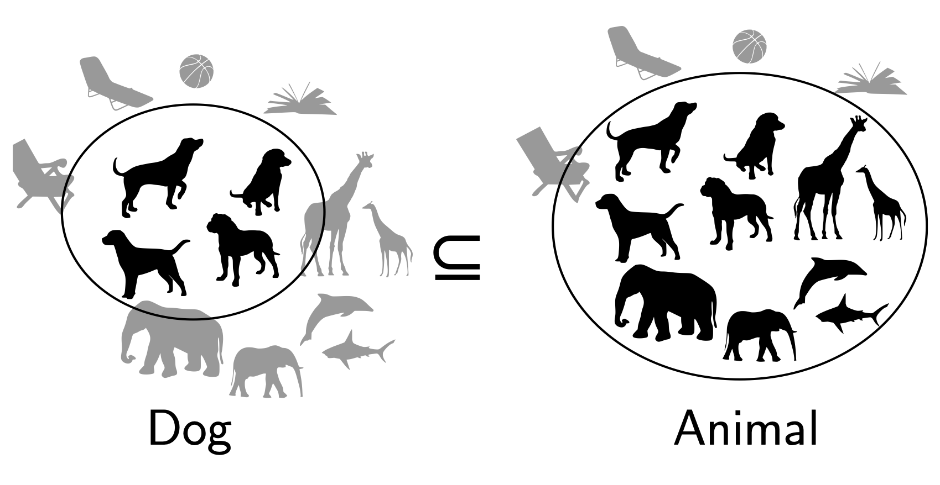
Entailment in formal semantics

Slide 4
Entailment in formal semantics
All animals have an ulnar artery
⇒
All dogs have an ulnar artery
+ Mathematically well-understood + Powerful machinery for handling logical operations
- Knowledge must come from somewhere else

Slide 5
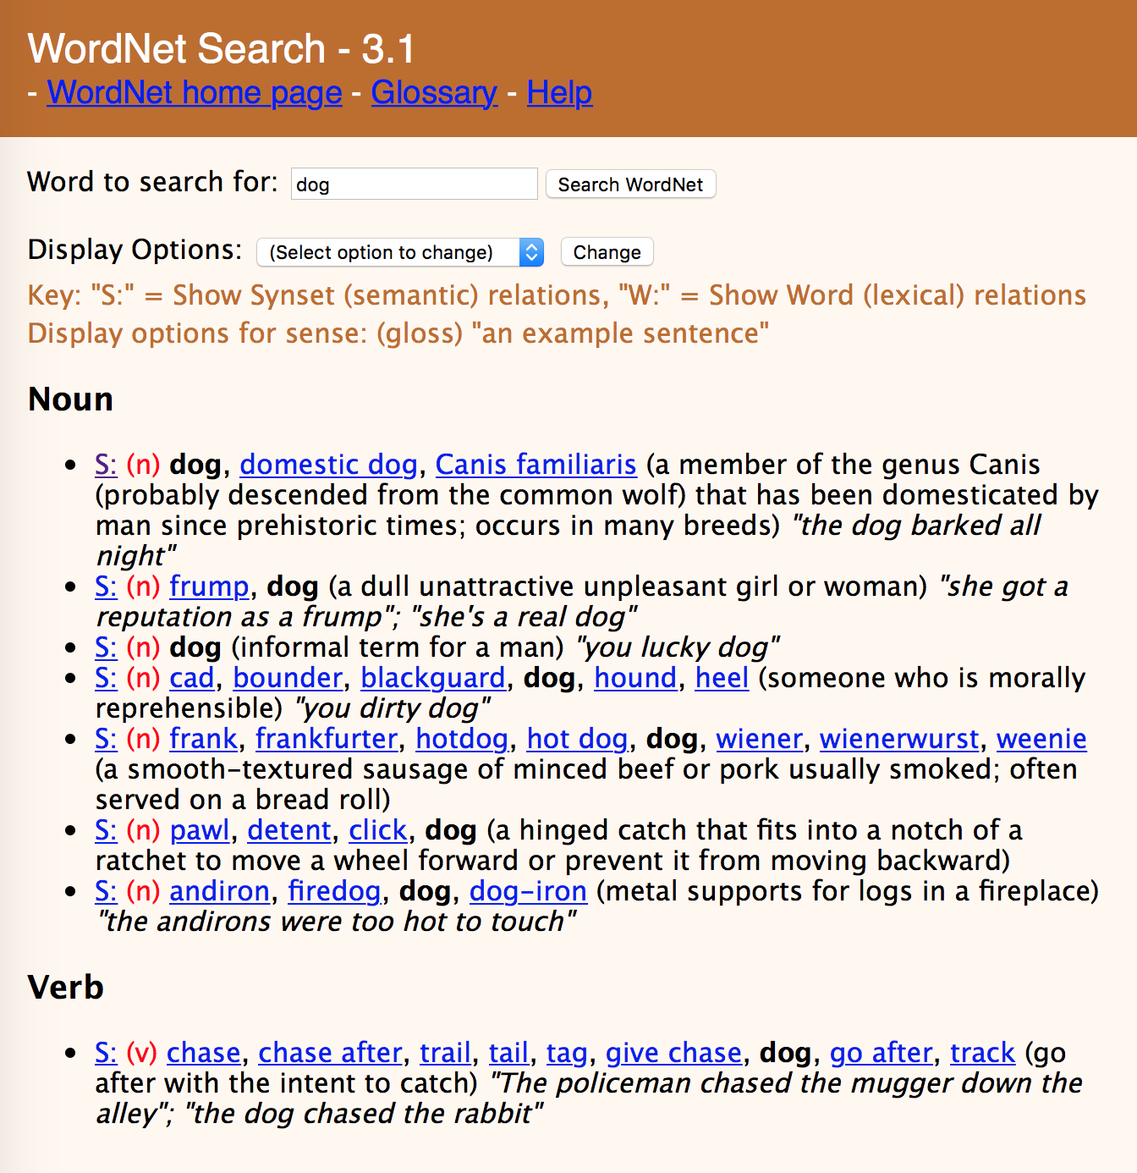

Slide 8
Lexical Semantics
act
communicate
perform
address
relay
practice
harangue
talk about
walk through
scrimmage
rant
descant
WordNet

Slide 9
Lexical Semantics
act
communicate
perform
address
relay
practice
harangue
talk about
walk through
scrimmage
rant
descant
WordNet
Vector Space Models
Notes:
VSMs have several attractive properties. VSMs extract knowledge automatically from a given corpus, thus they require much less labour than other approaches to semantics, such as hand-coded knowledge bases and ontologies.

Slide 10
Vector Space Models
Notes:
The idea of the VSM is to represent each word as a point in a space (a vector in a vector space). Points that are close together in this space are semantically similar and points that are far apart are semantically distant.

Slide 11
Dictionary Definitions
Noun
A small insect.
A harmful microorganism, as a bacterium or virus.
An enthusiastic, almost obsessive, interest in something. ‘they caught the sailing bug’
A miniature microphone, typically concealed in a room or telephone, used for surveillance.
An error in a computer program or system.
Verb
Conceal a miniature microphone in (a room or telephone) in order to monitor or record someone's conversations.
Annoy or bother (someone)
Notes:
Here the form bug is the lemma, also called the citation form. The form bug would also be the lemma for the word bugs; dictionaries don’t have separate definitions for inflected forms. Similarly sing is the lemma for sing, sang, sung. In many languages the infinitive form is used as the lemma for the verb, so Spanish dormir “to sleep” is the lemma for duermes “you sleep”. The specific forms sung or carpets or sing or duermes are called wordforms.

Slide 12
Polysemy
A word that has multiple meanings is called polysemous. We call each of these aspects of the meaning of bug a word sense.
Polysemy can make interpretation difficult.
What if someone types “caught a bug” into Google?
Word sense disambiguation is the task of determining which sense of a word is being used in a context.

Slide 13
Synonymy
When one word has a sense whose meaning is nearly identical to a sense of another word then those two words are synonyms.
glitch/error
microbe/bacterium
insect/pest
microphone/wire
Formally, two words are synonymous if they are substitutable one for the other in any sentence without changing the truth conditions of the sentence.
In logic, that means the two words carry the same propositional meaning.
Notes:
That means that all the situations in which the original sentence would be true, the sentence with the substitution would also be true.

Slide 14
Principle of Contrast
Linguists assume that a difference in form is always associated with a difference in meaning.
While substitutions like water/H₂O or father/dad are truth preserving, the words are still not identical in meaning.
H₂O is used in scientific contexts, but not general texts like hiking guides
Father is a more formal version of dad.
It is possible that no two words have absolutely identical meaning.

Slide 15
Word similarity
Most words don’t have many synonyms, but they do have a lot of similar words. Cat is not a synonym of dog, but cats and dogs are certainly similar words.
“fast” is similar to “rapid”
“tall” is similar to “height”
Useful for applications like question answering
Notes:
In moving from synonymy to similarity, it will be useful to shift from talking about relations between word senses (like synonymy) to relations between words (like similarity). Dealing with words avoids having to commit to a particular representation of word senses, which will turn out to simplify our task.

Slide 16
Word similarity
Most words don’t have many synonyms, but they do have a lot of similar words. Cat is not a synonym of dog, but cats and dogs are certainly similar words.
“fast” is similar to “rapid”
“tall” is similar to “height”
Useful for applications like Question Answering
Notes:
In moving from synonymy to similarity, it will be useful to shift from talking about relations between word senses (like synonymy) to relations between words (like similarity). Dealing with words avoids having to commit to a particular representation of word senses, which will turn out to simplify our task.

Slide 17
Word similarity
Can similar words be substituted in any sentence without changing its truth conditions? No.
How can we measure whether words are similar? One way is to ask humans to judge how similar one word is to another.
Word 1 | Word 2 | Similarity Score
Vanish | Disappear | 9.8
Tiger | Cat | 7.4
Love | Sex | 6.8
Muscle | Bone | 3.6
Cucumber | Professor | 0.3
Notes:
SimLex-999 dataset (Hill et al., 2015) gives values on a scale from 0 to 10, like the examples below, which range from near-synonyms (vanish, disappear) to pairs that scarcely seem to have anything in common (hole, agreement):

Slide 18
Word Relatedness
Words can still be related in ways other than being similar to each other.
Coffee and Cup are not similar because they don’t share any features
coffee is a plant or a beverage,
cup is a manufactured object made in a useful shape
But they’re related by co-participating in the same event.
Relatedness is measured with word association tests in psychology.
A semantic field is a set of words which cover a semantic domain and bear structured relations with each other.
Hospitals: surgeon, scalpel, nurse, anesthetic, hospital Restaurants: waiter, menu, plate, food, chef Houses: family, door, roof, kitchen, bed

Slide 19
Semantic Roles
An event like a commercial transaction described with different verbs
buy (the event from the perspective of the buyer),
sell (from the perspective of the seller),
pay (focusing on the monetary aspect),
Or with nouns like buyer.
Frames encode semantic roles (like buyer, seller, goods, money), and the words in a sentence that take on these roles.
Notes:
Closely related to semantic fields is the idea of a semantic frame. A semantic frame is a set of words that denote perspectives or participants in a particular type of event.
Knowing that buy and sell have this relation makes it possible for a system to know that a sentence like Sam bought the book from Ling could be paraphrased as Ling sold the book to Sam, and that Sam has the role of the buyer in the frame and Ling the seller. Being able to recognize such paraphrases is important for question answering, and can help in shifting perspective for machine translation.

Slide 20
Connotation
Words have affective meanings or connotations. Three important dimensions of affective meaning.
Valence – the pleasantness of the stimulus
Arousal – the intensity of emotion provoked by the stimulus
Dominance – the degree of control exerted by the stimulus
 | Valence | Arousal | Dominance
courageous | 8.05 | 5.5 | 7.38
music | 7.67 | 5.57 | 6.5
heartbreak | 2.45 | 5.65 | 3.58
cub | 6.71 | 3.95 | 4.24
life | 6.68 | 5.59 | 5.89

Slide 21
Points in space
Osgood et al. (1957) noticed that in using these 3 numbers to represent the meaning of a word, the model was representing each word as a point in a three-dimensional space
Part of the meaning of heartbreak can be represented as a vector with three dimensions corresponded to the word’s rating on the three scales.
heartbreak | 2.45 | 5.65 | 3.58

Slide 22
Vector Space Models
Notes:
The idea of the VSM is to represent each word as a point in a space (a vector in a vector space). Points that are close together in this space are semantically similar and points that are far apart are semantically distant.

Slide 23
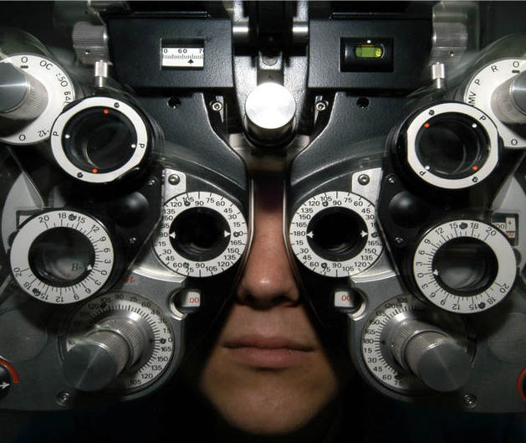
Distributional Hypothesis
If we consider optometrist and eye-doctor we find that, as our corpus of utterances grows, these two occur in almost the same environments. In contrast, there are many sentence environments in which optometrist occurs but lawyer does not...
It is a question of the relative frequency of such environments, and of what we will obtain if we ask an informant to substitute any word he wishes for optometrist (not asking what words have the same meaning).
These and similar tests all measure the probability of particular environments occurring with particular elements... If A and B have almost identical environments we say that they are synonyms.
–Zellig Harris (1954)
Notes:
Similar messages expressed by Wittgenstein (1953) and Firth (1957) who said “You shall know a word by the company it keeps.”
VSMs are interesting especially due to their relation with the distributional hypothesis and related hypotheses. The distributional hypothesis is that words that occur in similar contexts tend to have similar meanings. Efforts to apply this abstract hypothesis to concrete algorithms for measuring the similarity of meaning often lead to vectors, matrices, and higher-order tensors.

Slide 24
Intuition of distributional word similarity
Nida (1975) example: A bottle of tesgüino is on the table Everybody likes tesgüino Tesgüino makes you drunk We make tesgüino out of corn.
From context words humans can guess tesgüino means an alcoholic beverage like beer
Intuition for algorithm: Two words are similar if they have similar word contexts.

Slide 25
History of Vector Space Models
Vector Space Models were initially developed in the SMART information retrieval system (Salton, 1971)
Each document in a collection is represented as point in a space (a vector in a vector space)
A user’s query is a pseudo-document and is represented as a point in the same space as the documents
Perform IR by retrieving documents whose vectors are close together in this space to the query vector

Slide 26
Term-Document Matrix
 | D1 | D2 | D3 | D4 | D5
abandon
abdicate
abhor
academic
…
zygodactyl
zymurgy
Notes:
Documents can be things like Shakespeare’s plays, or novels, or web pages

Slide 27

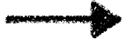
Term-Document Matrix
 | D1 | D2 | D3 | D4 | D5
abandon
abdicate
abhor
academic
…
zygodactyl
zymurgy
Each column vector
represents a Document
Notes:
Documents can be things like Shakespeare’s plays, or Wikipedia pages, or IMDB reviews for a movie.

Slide 28
Term-Document Matrix
 | D1 | D2 | D3 | D4 | D5
abandon
abdicate
abhor
academic
…
zygodactyl
zymurgy
Each row vector
represents a Term

Slide 29


Term-Document Matrix
 | D1 | D2 | D3 | D4 | D5
abandon
abdicate
abhor
academic
…
zygodactyl
zymurgy
The value in a cell is
based on how often that term
occurred in that document

Slide 30
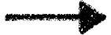
Term-Document Matrix
}
 | D1 | D2 | D3 | D4 | D5
abandon
abdicate
abhor
academic
…
zygodactyl
zymurgy
The length of the
document vectors
is the size of the vocabulary

Slide 31
Term-Document Matrix
 | D1 | D2 | D3 | D4 | D5
abandon
abdicate
abhor
academic
…
zygodactyl
zymurgy
Document vectors
can be sparse
(most values are 0)

Slide 32

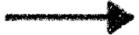
Term-Document Matrix
 | D1 | D2 | D3 | D4 | D5
abandon
abdicate
abhor
academic
…
zygodactyl
zymurgy
We can measure
how similar two
documents are
by comparing their
column vectors

Slide 33
What can document similarity let you do?

Slide 34
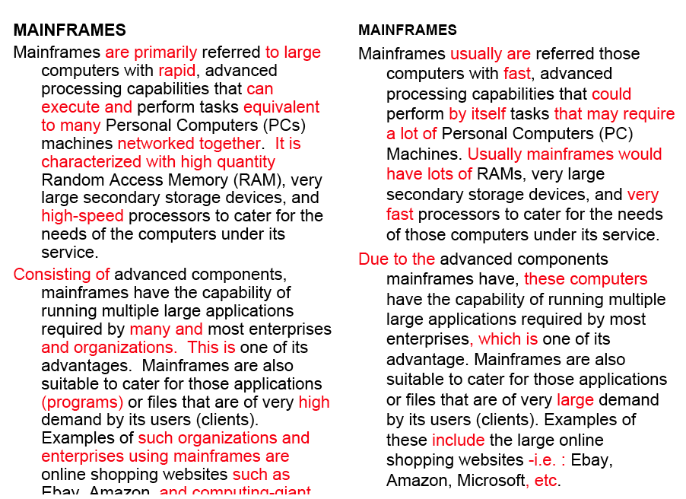
Word similarity for plagiarism detection

Slide 35



Term-Document Matrix
 | D1 | D2 | D3 | D4 | D5
abandon
abdicate
abhor
academic
…
zygodactyl
zymurgy
What does comparing
two row vectors do?
Notes:
It measures the similarity between words!

Slide 36
Vector comparisons
 | docX | docY
A | 2 | 4
B | 10 | 15
C | 14 | 10
Notes:
docY is a positive movie review
docx is a less positive movie review
A = "superb" positive / low frequency
B = "good" positive / high frequency
C = "disappointing" negative / high frequency

Slide 37
Vector comparisons
 | docX | docY
A | 2 | 4
B | 10 | 15
C | 14 | 10
docY is a positive movie review
docx is a less positive movie review
A = "superb" positive / low frequency
B = "good" positive / high frequency
C = "disappointing" negative / high frequency
Notes:
docY is a positive movie review
docx is a less positive movie review
A = "superb" positive / low frequency
B = "good" positive / high frequency
C = "disappointing" negative / high frequency

Slide 38
Vector comparisons
 | docX | docY
A | 2 | 4
B | 10 | 15
C | 14 | 10
Notes:
Euclidean distance : vectors u, v of dimension N
sqrt (sum_i to N ( | ui - vi|² ) )
A to B is sqrt of | 2-10 |² + | 4-15 |² = 13.6
B to C is sqrt of | 10-14 |² + | 15-10 |² = 6.4
A = Superb, B = Good, C=Disappointing
Goal: related words are close, and unrelated words are far apart.
Did we do it?

Slide 39
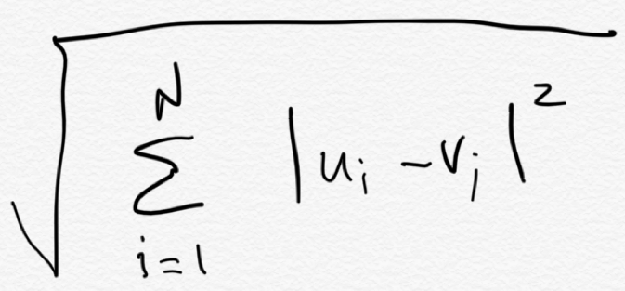
Vector comparisons
Euclidean distance
 | docX | docY
A | 2 | 4
B | 10 | 15
C | 14 | 10
B
distance = 6.4
distance = 13.6
C
Euclidean distance : vectors u, v of dimension N
A

Slide 40
Vector comparisons
Oh no! Good is
closer to Disappointing
than to Superb.
Euclidean distance
 | docX | docY
A | 2 | 4
B | 10 | 15
C | 14 | 10
B = Good
distance = 6.4
distance = 13.6
C = Disappointing
Euclidean distance : vectors u, v of dimension N
A = Superb

Slide 41
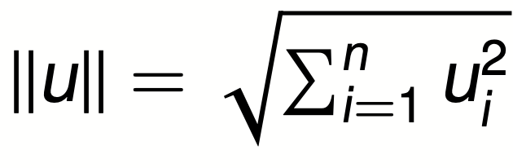
Vector L2 (length) Normalization
 | docX | docY
A | 2 | 4
B | 10 | 15
C | 14 | 10
||u||
4.47
18.02
17.20

Slide 42
Vector L2 (length) Normalization
 | docX | docY
A | 2/4.47 | 4/4.47
B | 10/18.02 | 15/18.02
C | 14/17.2 | 10/17.2
||u||
4.47
18.02
17.20
Divide each vector by its L2 length

Slide 43
Vector comparisons
 | docX | docY
A | 2 | 4
B | 10 | 15
C | 14 | 10
Notes:
Euclidean distance : vectors u, v of dimension N
sqrt (sum_i to N ( | ui - vi|² ) )
A to B is sqrt of | 2-10 |² + | 4-15 |² = 13.6
B to C is sqrt of | 10-14 |² + | 15-10 |² = 6.4
A = Superb, B = Good, C=Disappointing
Goal: related words are close, and unrelated words are far apart.
Did we do it?

Slide 44
Vector L2 (length) Normalization
 | docX | docY
Ȧ | 0.45 | 0.89
Ḃ | 0.55 | 0.83
Ċ | 0.81 | 0.58
A = Superb
B = Good
C = Disappointing
Now Good is
closer to Superb
than to Disappointing

Slide 45
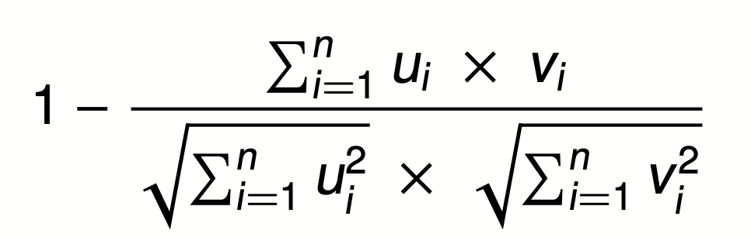

Cosine Distance
A = Superb
B = Good
C = Disappointing
Cosine does the L2
normalization too
Cosine angle between
vectors tells us their similarity

Slide 46
Term-Term Matrix
 | abandon | abdicate | abhor | … | zymurgy
abandon
abdicate
abhor
academic
…
zygodactyl
zymurgy
Notes:
Defines a co-occurrence matrix
w-2, w-1 target word w+1 w+2

Slide 47
Term-Term Matrix
AKA Term-Context Matrix
 | abandon | abdicate | abhor | … | zymurgy
abandon
abdicate
abhor
academic
…
zygodactyl
zymurgy
Length of the vector is now |V|
instead of number of documents
Notes:
|V| = size of vocabulary

Slide 48
Term-Term Matrix
AKA Term-Context Matrix
 | abandon | abdicate | abhor | … | zymurgy
abandon
abdicate
abhor
academic
…
zygodactyl
zymurgy
The value in a cell indicates how
often abandon appears in a
context window surrounding
abdicate
Notes:
Defines a co-occurrence matrix
w-2, w-1 target word w+1 w+2

Slide 49
Context windows
w-2, w-1 target_word w+1 w+2
The government most not abdicate responsibility to non-elected
it has led men to abdicate their family responsibilities
other demands, but declining to abdicate his responsibility
leaders abdicate their role and present people with no plans
 | his | leaders | not | responsibility | to
abandon | 1 | 1 | 1 | 2 | 3
Notes:
Defines a co-occurrence matrix
w-2, w-1 target word w+1 w+2

Slide 50
Context windows
Occur in a window of +/- 2 words, in the same sentence, in the same document
Instead of window of words use more complex contexts: dependency patters. Subj-of-verb, adj-mod, obj-of-verb
Languages have long distance dependencies The pictures are beautiful. The pictures of the old man are beautiful. The pictures of the old man holding his grandchild are beautiful.
Notes:
Defines a co-occurrence matrix
w-2, w-1 target word w+1 w+2

Slide 51
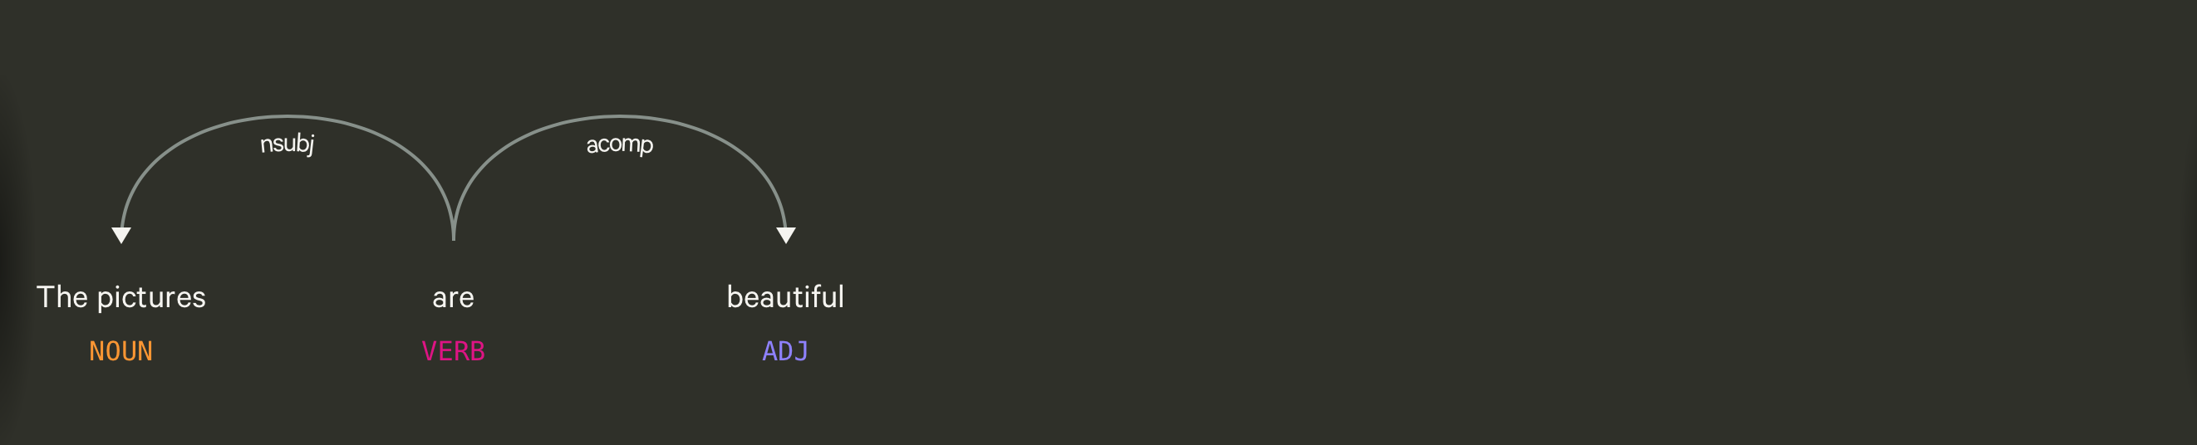
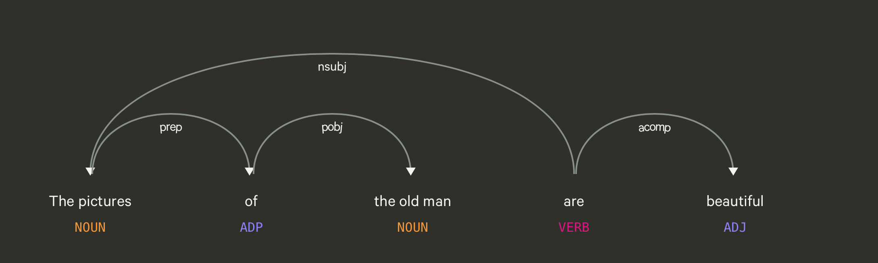
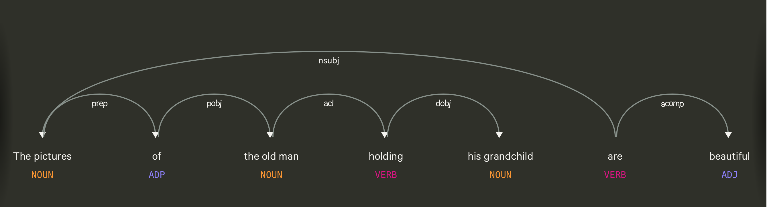

Slide 52
Using syntax to define a word’s context
Zellig Harris (1968) “The meaning of entities, and the meaning of grammatical relations among them, is related to the restriction of combinations of these entities relative to other entities”
Duty and Responsibility have similar syntactic distributions
Modified by adjectives | additional, administrative, assumed, collective, congressional, constitutional …
Object of verbs | assert, assign, assume, attend to, avoid, become, breach..

Slide 53
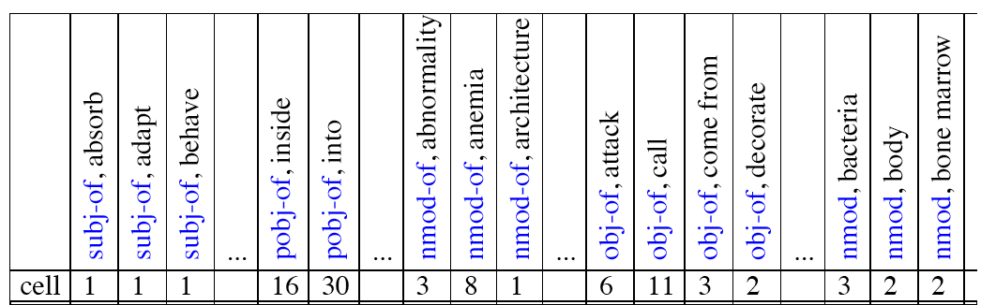
Co-occurrence vectors based on syntactic dependencies
Dekang Lin, 1998 “Automatic Retrieval and Clustering of Similar Words”

Slide 54
Alternates to counts
Raw word frequency is not a great measure of association between words. It’s very skewed “the” and “of” are very frequent, but maybe not the most discriminative
We’d rather have a measure that asks whether a context word is particularly informative about the target word.
Instead of raw counts, it’s common to transform vectors using TF-IDF or PPMI
Notes:
I’m going to skip the definition of PPMI for this talk

Slide 55
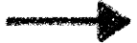

TF-IDF
Term frequency * inverse document frequency
How often a
word occurred in
a document
1 over the number
of documents that it
occurred in
Notes:
What does this do to a word like the?

Slide 56
Sparse v. Dense Vectors
Co-occurrence matrix (weighted by TF-IDF or mutual information)
Long (length |V| = 50,000+)
Sparse (most elements are zeros)
Alternative: learn vectors that are
Short (length 200-1000)
Dense (most elements are non-zero)
Notes:
ccb - future todo - Re-work as a visual?

Slide 57
How do we get dense vectors?
One recipe: train a classifier!
1. Treat the target word and a neighboring context word as positive examples.
2. Randomly sample other words in the lexicon to get negative samples.
3. Use logistic regression to train a classifier to distinguish those two cases.
4. Use the weights as the embeddings.

Slide 58
Word2Vec
Mikolov et al. 2013
Learn embeddings as part of the process of word prediction.
Train a classifier to predict neighboring words
Inspired by neural net language models.
In so doing, learn dense embeddings for the words in the training corpus.
Advantages:
Fast, easy to train (much faster than SVD)
Available online in the word2vec package Including sets of pretrained embeddings!

Slide 59
Word2Vec
Predict each neighboring word in a context window of 2C of surrounding words
So for C=2, we are given a word wt and we try to predict its 4 surrounding words
[wt-2, wt-1, wt+1, wt+2]
Uses "negative sampling" for training

Slide 60
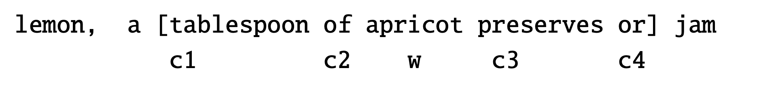
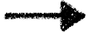
Negative sampling
We want predictions
of these words to be high
And these words to be low

Slide 61
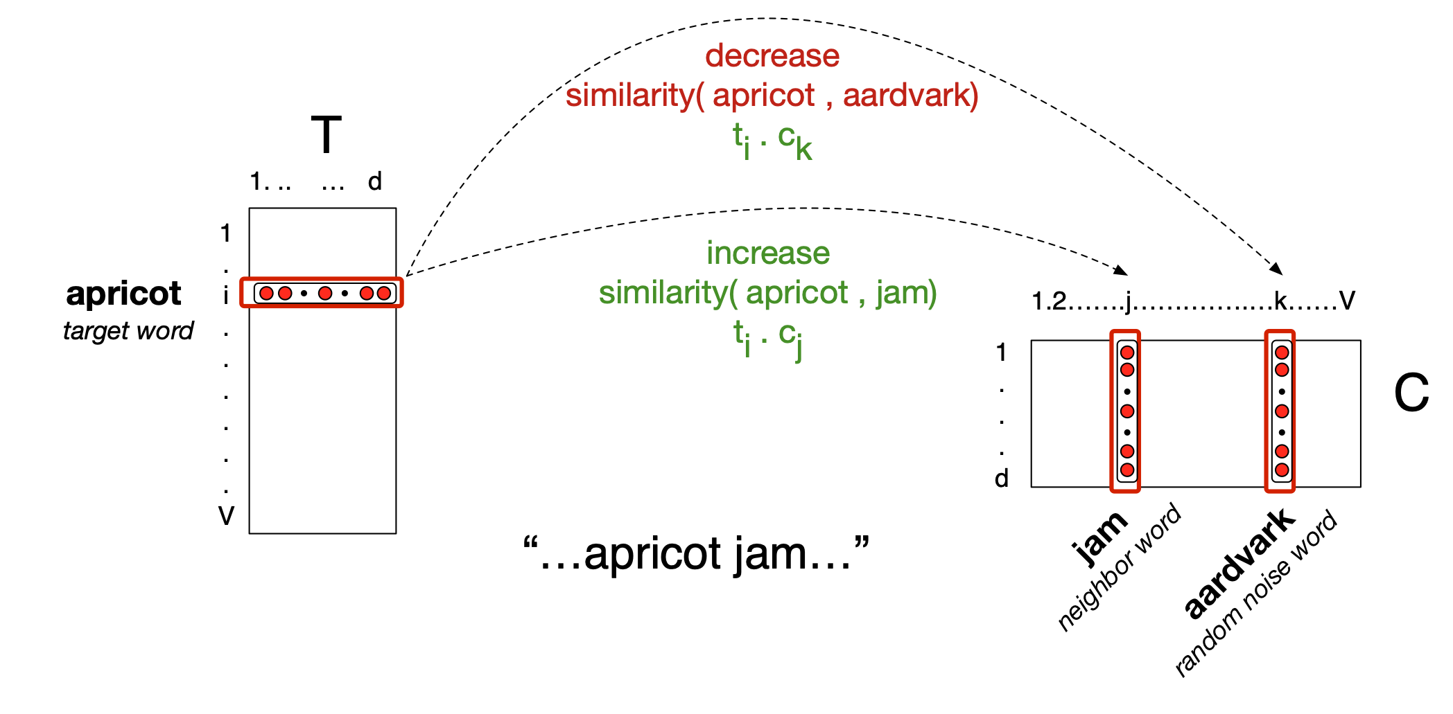
Neural Network

Slide 62
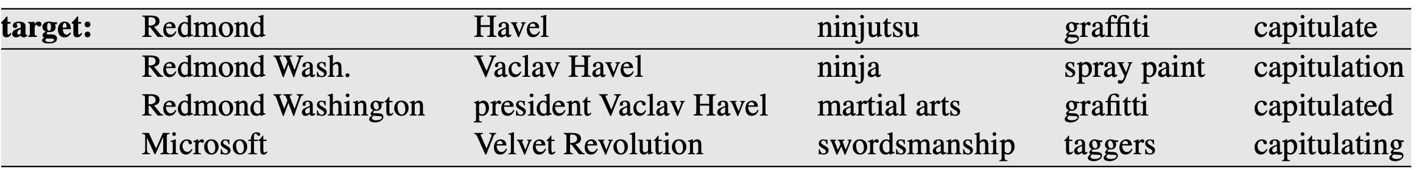
Properties of Embeddings
Nearest Neighbors are surprisingly good

Slide 63
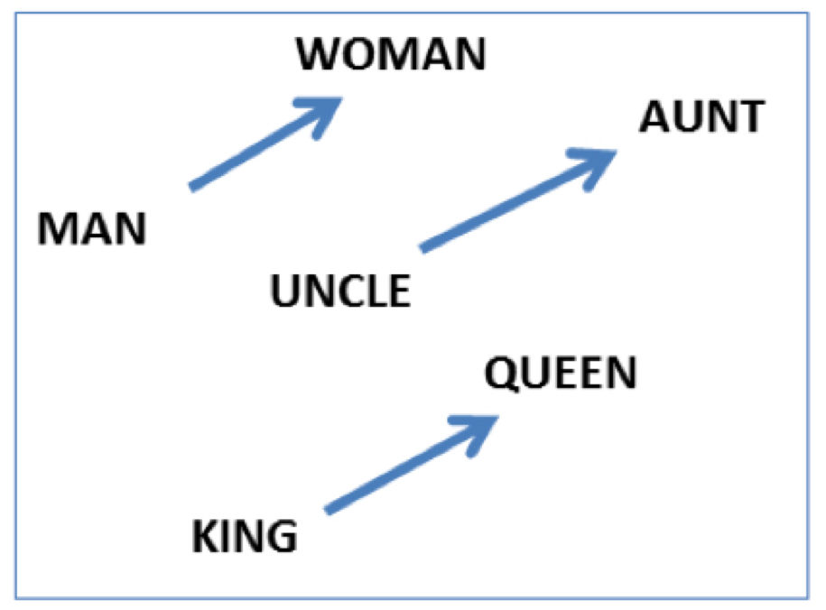
Embeddings capture relational meanings
.vector('king') - vector('man') + vector('queen') ≅ vector('woman')

Slide 64
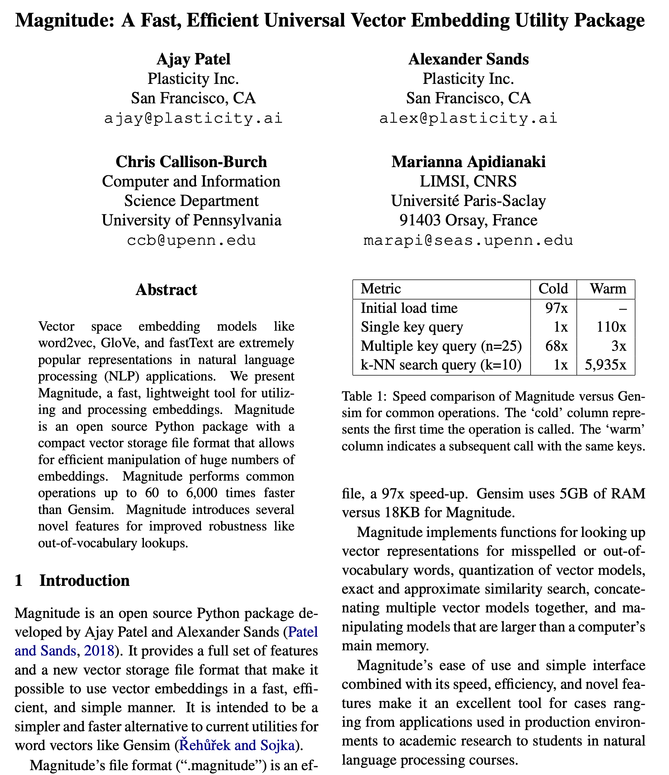

Slide 65
Demo of word vectors
# Install Magnitude
pip3 install pymagnitude
# Download Google’s word2vec vectors
wget http://magnitude.plasticity.ai/word2vec+approx/GoogleNews-vectors-negative300.magnitude
# Warning it’s 11GB large
# Start Python, and try the commands
# on the next slide
python3

Slide 66
Demo of word vectors
from pymagnitude import *
vectors = Magnitude("GoogleNews-vectors-negative300.magnitude")
queen = vectors.query('queen')
king = vectors.query("king")
vectors.similarity(king, queen)
# 0.6510958
vectors.most_similar_approx(king, topn=5)
#[('king', 1.0), ('kings', 0.72), ('prince', 0.62), ('sultan', 0.59), ('ruler', 0.58)]

Slide 67
Many possible models
Matrix type
Term-document
Term-context
Pattern-pair
Reweighting
length norm.
TF-IDF
PPMI
probabilities
Comparisons
cosine
Manhattan
Jaccard
KL divergence
JS distance
DICE
Dim. Reduction
word2vec
GloVe
PCA
LDA
LSA
How many dimensions?
What modifications should we make to the input?
Notes:
Modifications: tokenization/normalization, annotation/tagger, parsing, cluster text by author/time/etc.

